Slide 1
Android Sensor

Slide 2
Sensor
A converter that measures a physical quantity and converts it into a signal which can be read by an observer or by an instrument
Exm :
Microphone, number keys, touch screen, camera, GPS, etc..

Slide 3
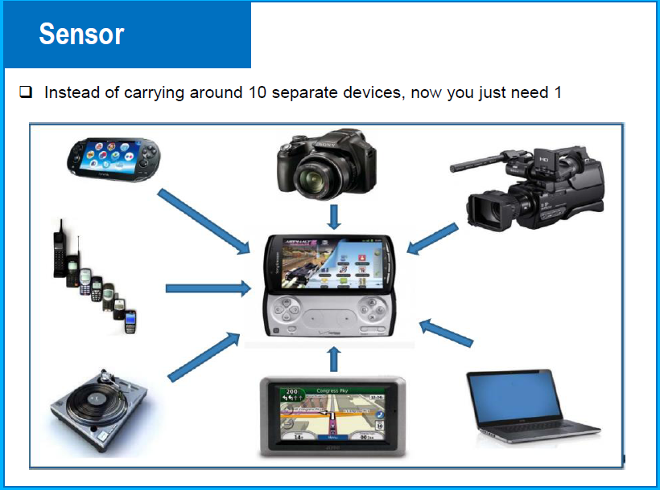
Android Sensor

Slide 4
Android Sensor
The Android platform supports three broad categories of sensors:
Motion sensors These sensors measure acceleration forces and rotational forces along three axes. This category includes accelerometers, gravity sensors, gyroscopes, and rotational vector sensors.
Environmental sensors These sensors measure various environmental parameters, such as ambient air temperature and pressure, illumination, and humidity. This category includes barometers, photometers, and thermometers.
Position sensors These sensors measure the physical position of a device. This category includes orientation sensors and magnetometers.

Slide 5
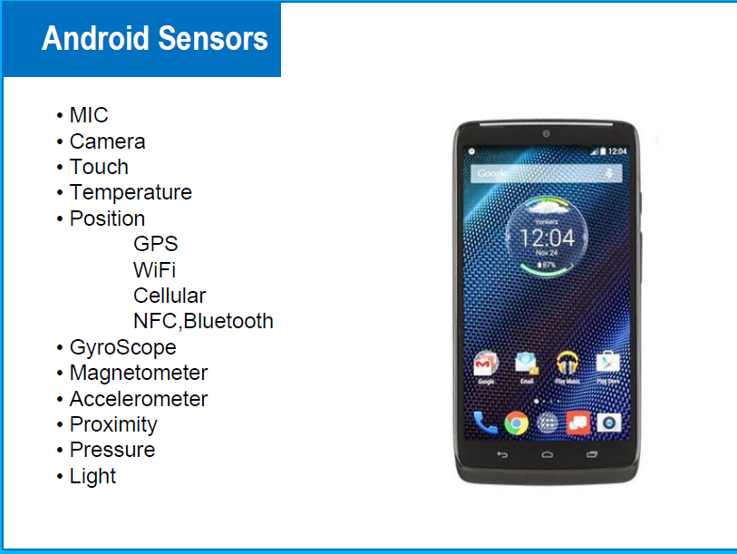
Android Sensor

Slide 6
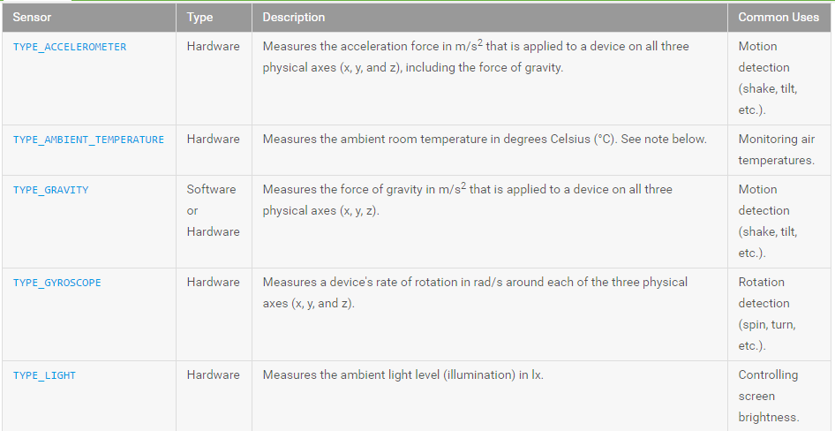
Sensor Type Supported by Android palform
https://developer.android.com/guide/topics/sensors/sensors_overview#java

Slide 7
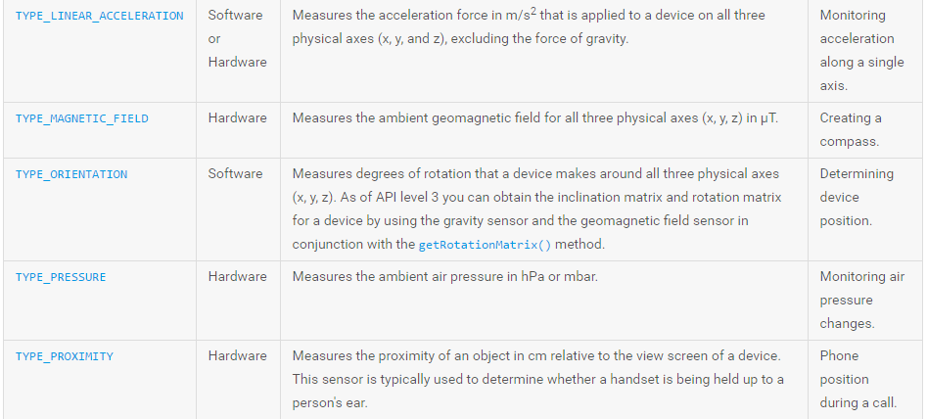
Sensor Type Supported by Android palform
https://developer.android.com/guide/topics/sensors/sensors_overview#java

Slide 8
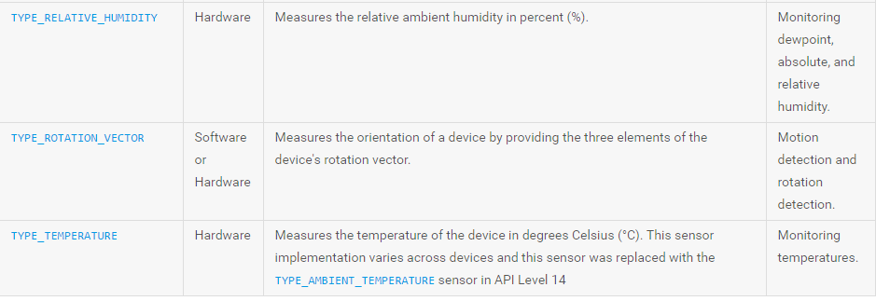
Sensor Type Supported by Android palform
https://developer.android.com/guide/topics/sensors/sensors_overview#java

Slide 9
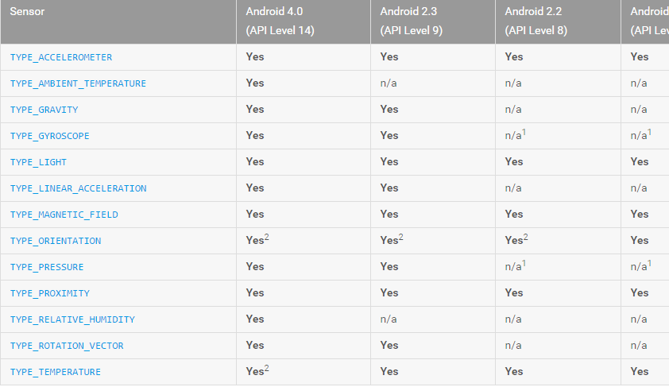
Sensor availability by platform.
https://developer.android.com/guide/topics/sensors/sensors_overview#java

Slide 10
Sensor Framework
You can access these sensors and acquire raw sensor data by using the Android sensor framework. The sensor framework is part of the android.hardware package and includes the following classes and interfaces:
SensorManager
Sensor
SensorEvent
SensorEventListener

Slide 11
SensorManager class
The android.hardware.SensorManager class provides methods :
to get sensor instance,
to access and list sensors,
to register and unregister sensor listeners etc.
You can get the instance of SensorManager by calling the method getSystemService() and passing the SENSOR_SERVICE constant in it.
SensorManager sm = (SensorManager)getSystemService(SENSOR_SERVICE);
Memperoleh semua sensor dengan tipe tertentu , menggunakan methode getSensorList( tipe sensor ). Gunakan tipe sensor Sensor.TYPE_ALL untuk mendapatkan seluruh sensor bertipe apapun yang ada pada device
list = sm.getSensorList(Sensor.TYPE_ACCELEROMETER); //memperoleh semua sensor tipe accelerometer yang ada pada device

Slide 12
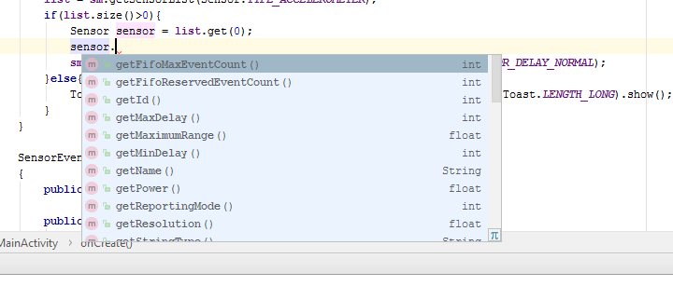
Sensor class
The android.hardware.Sensor class provides methods to get information of the sensor such as sensor name, sensor type, sensor resolution, sensor type etc.

Slide 13
SensorEventListener interface
It provides two call back methods to get information when sensor values (x,y and z) change or sensor accuracy changes.
Public and abstract methods | Description
void onAccuracyChanged(Sensor sensor, int accuracy) | it is called when sensor accuracy is changed.
void onSensorChanged(SensorEvent event) | it is called when sensor values are changed.

Slide 14
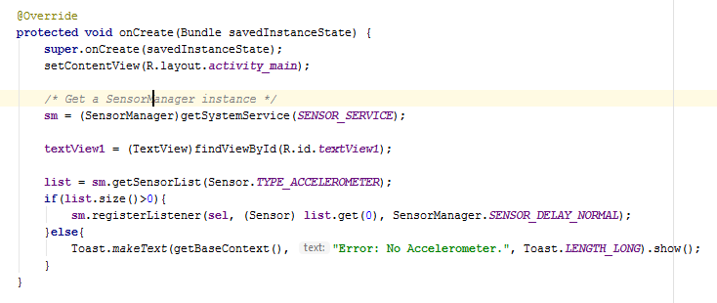
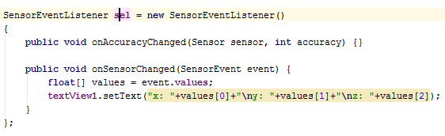

Slide 15
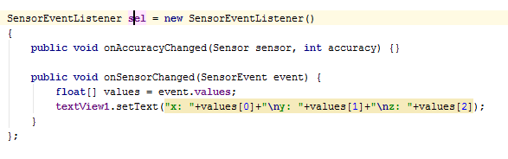
SensorEvent class
Its instance is created by the system. It provides information about the sensor.

Slide 16
MAIN TASK
1.Determine which sensors are available on a device.
2.create sensor event listeners object and implement callbacks (onAccuracyChange dan onSensorSchange)
3. Register sensor event listeners that monitor sensor changes.
4. UnRegister sensor event listeners : Be sure to unregister a sensor's listener when you are done using the sensor or when the sensor activity pauses

Slide 17
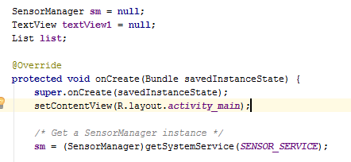
Get a SensorManager instance

Slide 18
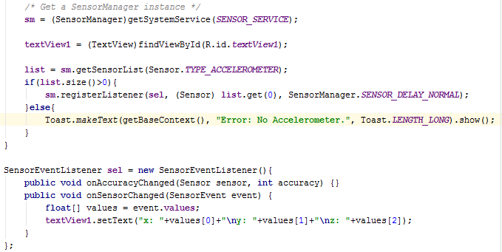
Register Sensor Listener

Slide 19
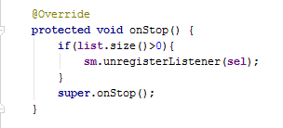

Unregister sensor

Slide 20
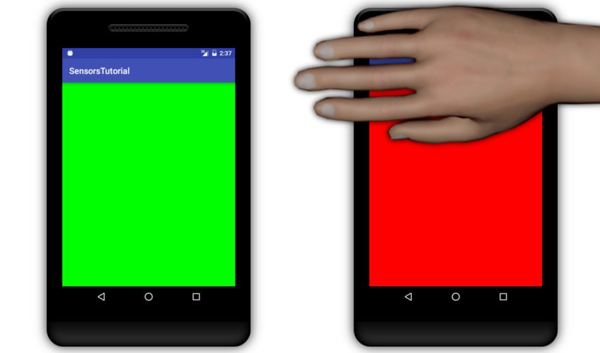
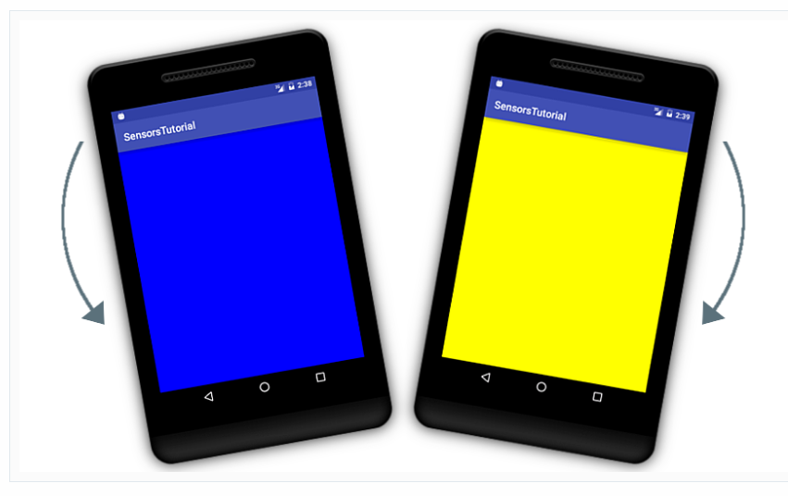
Tugas

